Slide 1
50 Years of Music Trends
A sentiment analysis of pop music over time

Slide 2
AGENDA
Background – Haroon Ahmad (2 min)
Analysis – Jeffrey Box (2 min)
Conclusion – Gyuheui Choi (2 min)
Way Forward – Richard Moses (2 min)

Slide 3
BACKGROUND
Claim: Pop music is a influential reflection of culture. It is possible to “measure” music by conducting sentiment analysis on lyrics of popular songs through time.
Null Hypothesis (H₀) : The sentiments of popular song lyrics have not changed over time.
Alternate Hypothesis (H_{a}) : The sentiments of popular song lyrics have changed over time.

Slide 4
APPROACH
Statistical Regression Modeling
Pseudocode
Identifying Data Sources & Dependencies
Collect a random list of songs over 50 years
Query lyrics for the songs
Run sentiment analysis
Analyze results
Billboard.py
= “Hot-100” str
MusixMatch.py
= JSON dict.
VaderSentiment
= scores
Notes:
Our Dataset is comprised of randomly selected weeks using Billboard top 100, for every year from 1968 till 2017
This data is accessed using, a Python API for downloading Billboard Charts.
To find song lyrics, we used the API.
SentimentIntensityAnalyzer()

Slide 5




SENTIMENT ANALYSIS: EXAMPLES
From VaderSentiment Import SentimentIntensityAnalyzer()
"I love you, you love me, we're a happy family, with a great big hug and a kiss from me to you"
0.0 | 0.352 | 0.648 | 0.9723
“Your mom is a dog”
0.0 | 1.0 | 0.0 | 0.0
“Huh, because I'm happy, Clap along if you feel like a room without a roof, Because I'm happy Clap along if you feel like happiness is the truth, Because I'm happy Clap along if you know what happiness is to you, Because I'm happy Clap along if you feel like that's what you wanna do
0.0 | 0.575 | 0.425 | 0.984
F*** that shit, 'cause I ain't the one, for a punk mother****er with a badge and a gun, to be beating on, and thrown in jail, We can go toe to toe in the middle of a cell"
0.379 | 0.621 | 0.0 | -0.952
Notes:
The compound score is computed by summing the valence scores of each word in the lexicon, adjusted according to the rules, and then normalized to be between -1 (most extreme negative) and +1 (most extreme positive). This is the most useful metric if you want a single unidimensional measure of sentiment for a given sentence. Calling it a 'normalized, weighted composite score' is accurate.

Slide 6
S1
R = 0.65
R² = 0.42
Std Err = 7.3e-05
P-Value = 3.1e-7
Notes:
Jeff’s data

Slide 7
S1
R = -0.66
R² = 0.44
Std Err = 0.00
P-Value = 1.6e-07

Slide 8
S1
R = 0.23
R² = 0.05
Std err = 0.00
P-Value = 0.11

Slide 9
S1
R = -0.66
R² = 0.43
Std Err = 0. 00
P-Value = 1.9e-07

Slide 10
CONCLUSION
S1
Trial | R | R² | Std Err | P-Value
S1 | .65 | .42 | 0+ | 0+
S2 | .73 | .53 | 0+ | 0+
S3 | .68 | .46 | 0+ | 0+
S4 | .68 | .45 | 0+ | 0+
Approximately 42+% of the variation in negative sentiment score is accounted for by the variation time. We feel comfortable, because the data is approximately normally distributed based on the shape of the histogram. Additionally, the p-value is 0+ which is < 0.05.
We reject the null hypothesis (Ho) in favor of the alternative. These two variables are related

Slide 11




WAY FORWARD
Limitations & Considerations
Billboard data starts at 1968
MusixMatch’s free plan is a limited API
VaderSentiment Analysis is “specifically attuned to … social media.”
Consider other KPIs
Business Implications
What music should artists produce, and what should be marketed?
Can we accurately filter songs based on Vader (i.e. clean vs explicit lyrics)?
Can we exploit song lyrics to sell a product or service?
Notes:
- to 30% of song’s lyrics and 2000 calls or 500 lyrics per day
- Scrub outliers in data set

Slide 12
Questions??

Slide 13
APPENDIX
Jupyter Notebook Snippets

Slide 14
RESOURCES
MusixMatch source:
https://developer.musixmatch.com/documentation/api-reference/track-lyrics-get
MusixMatch python library:
https://github.com/hudsonbrendon/python-musixmatch
Billboard python library:
https://github.com/guoguo12/billboard-charts
Vader Sentiment Analysis python library:
Vader Sentiment Analysis https://github.com/cjhutto/vaderSentiment
Additional libraries:
numpy, pandas, random, datetime, matplotlib.pyplot, and scipy.stats (for linear regression – linregress)

Slide 15
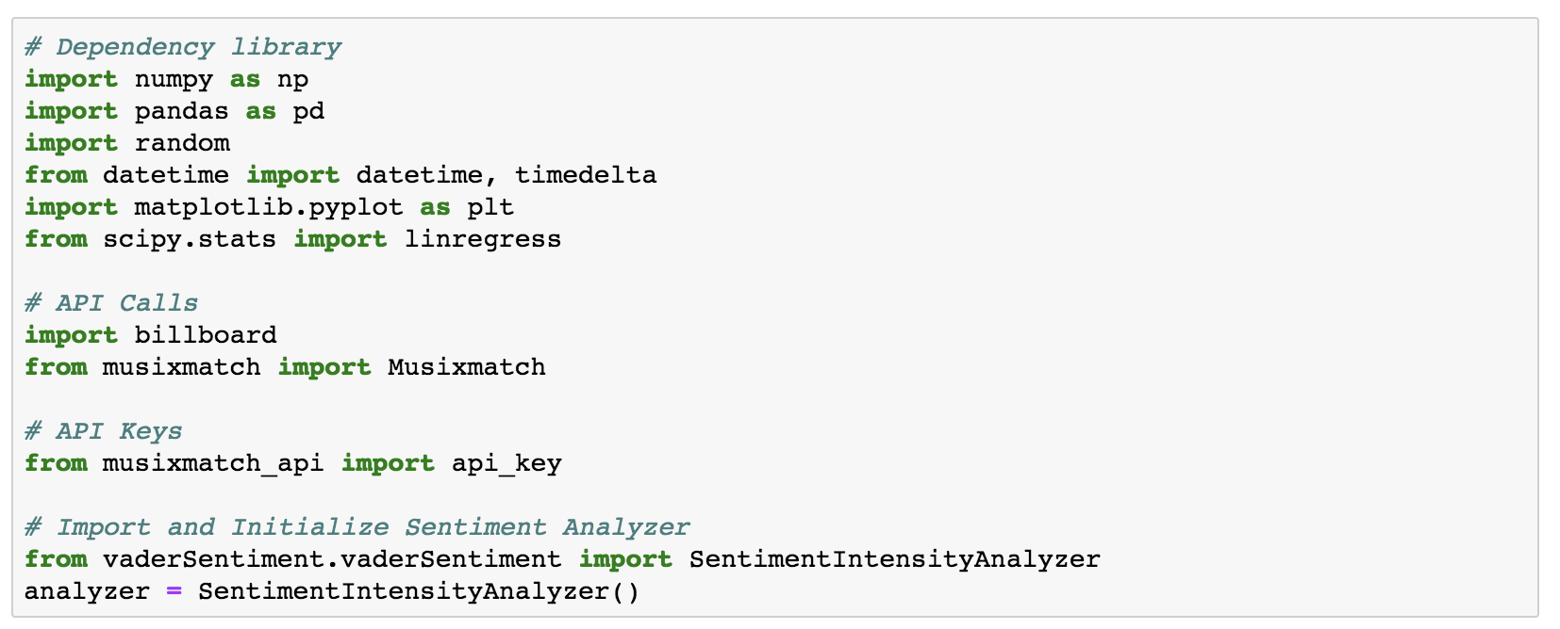
CODE (1) - Dependencies

Slide 16
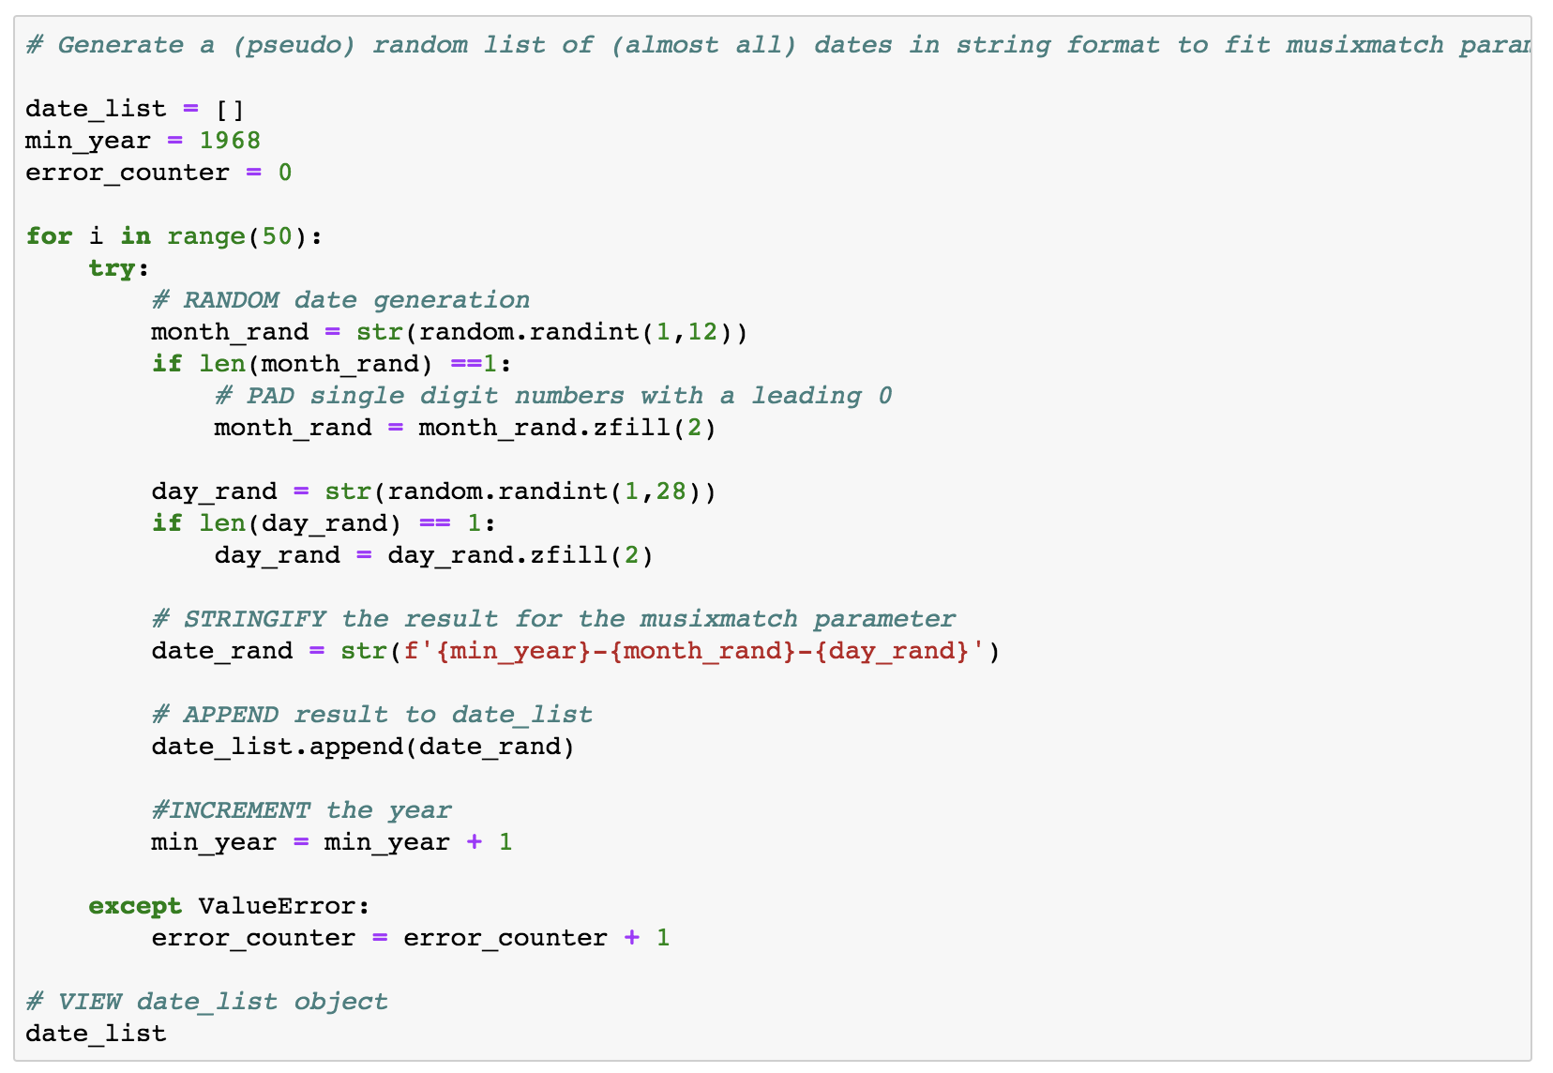
CODE (2) – Generating Random Dates

Slide 17
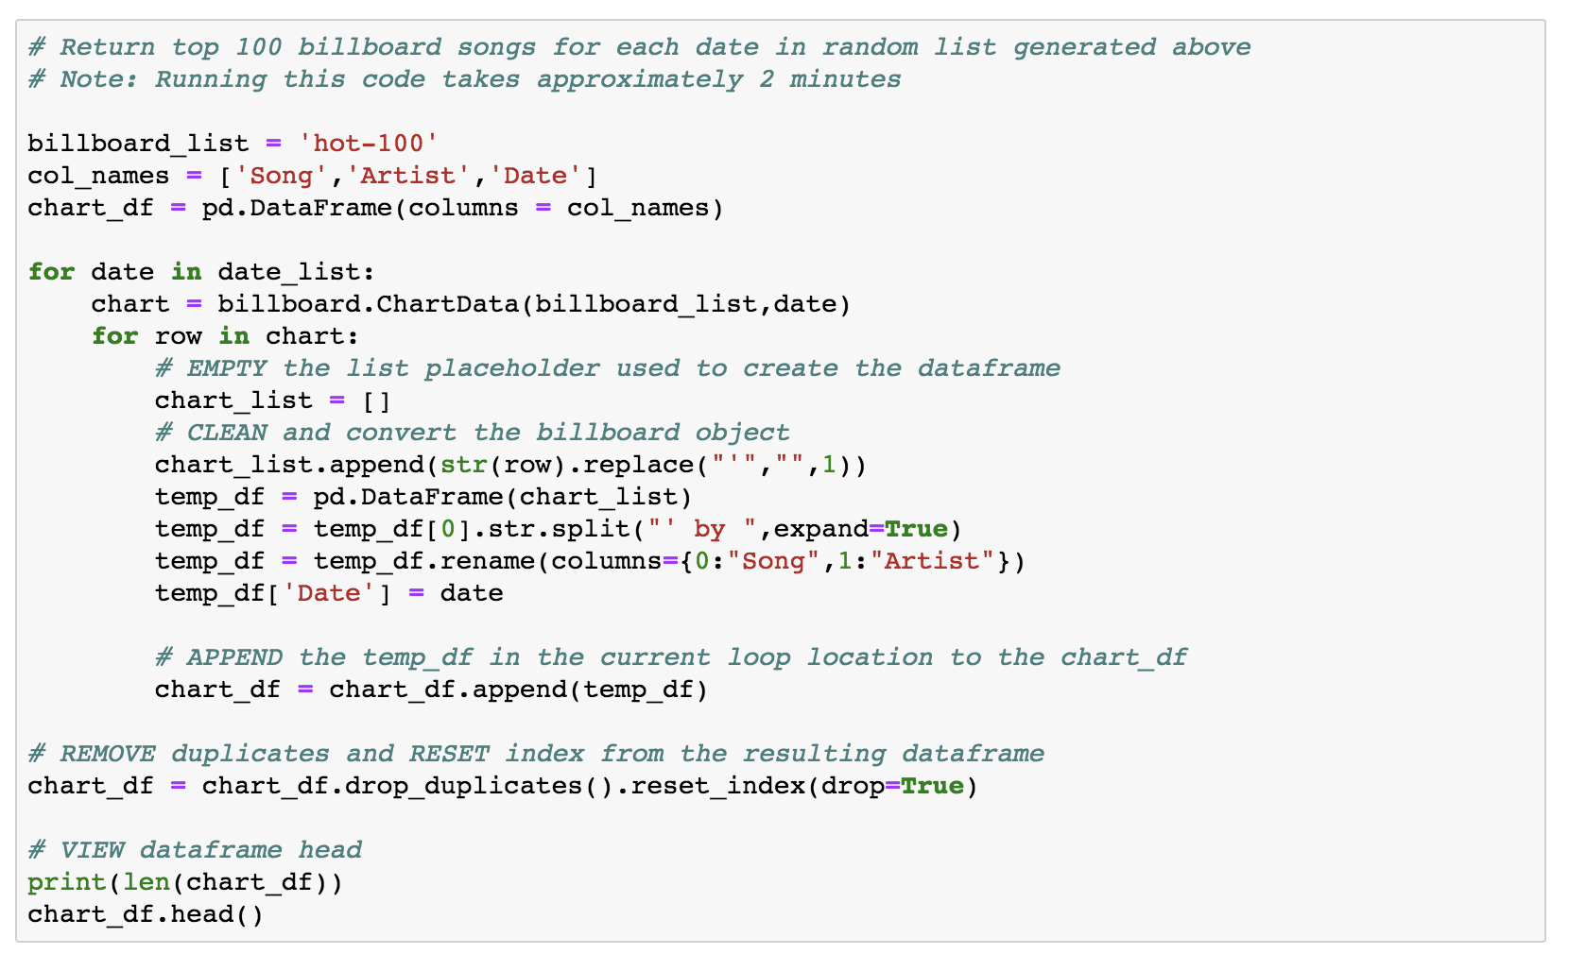
CODE (3) – Querying Billboard ‘Hot 100’
* Small block to split date strings following this block

Slide 18
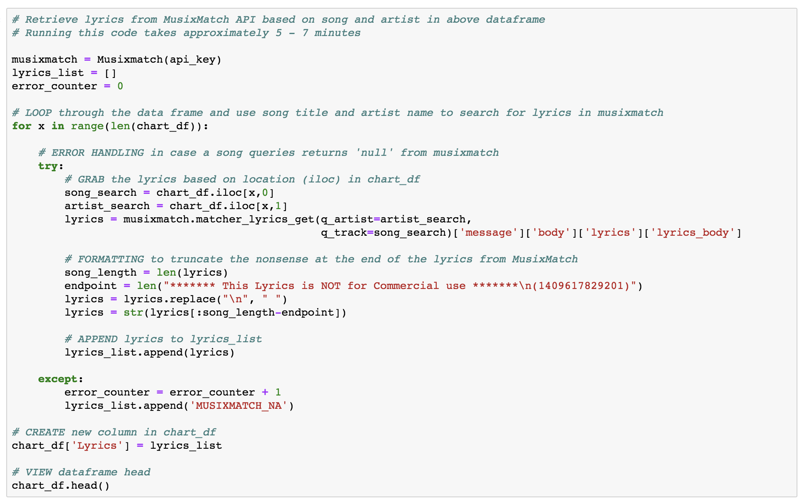
CODE (4) – Query MusixMatch lyrics

Slide 19
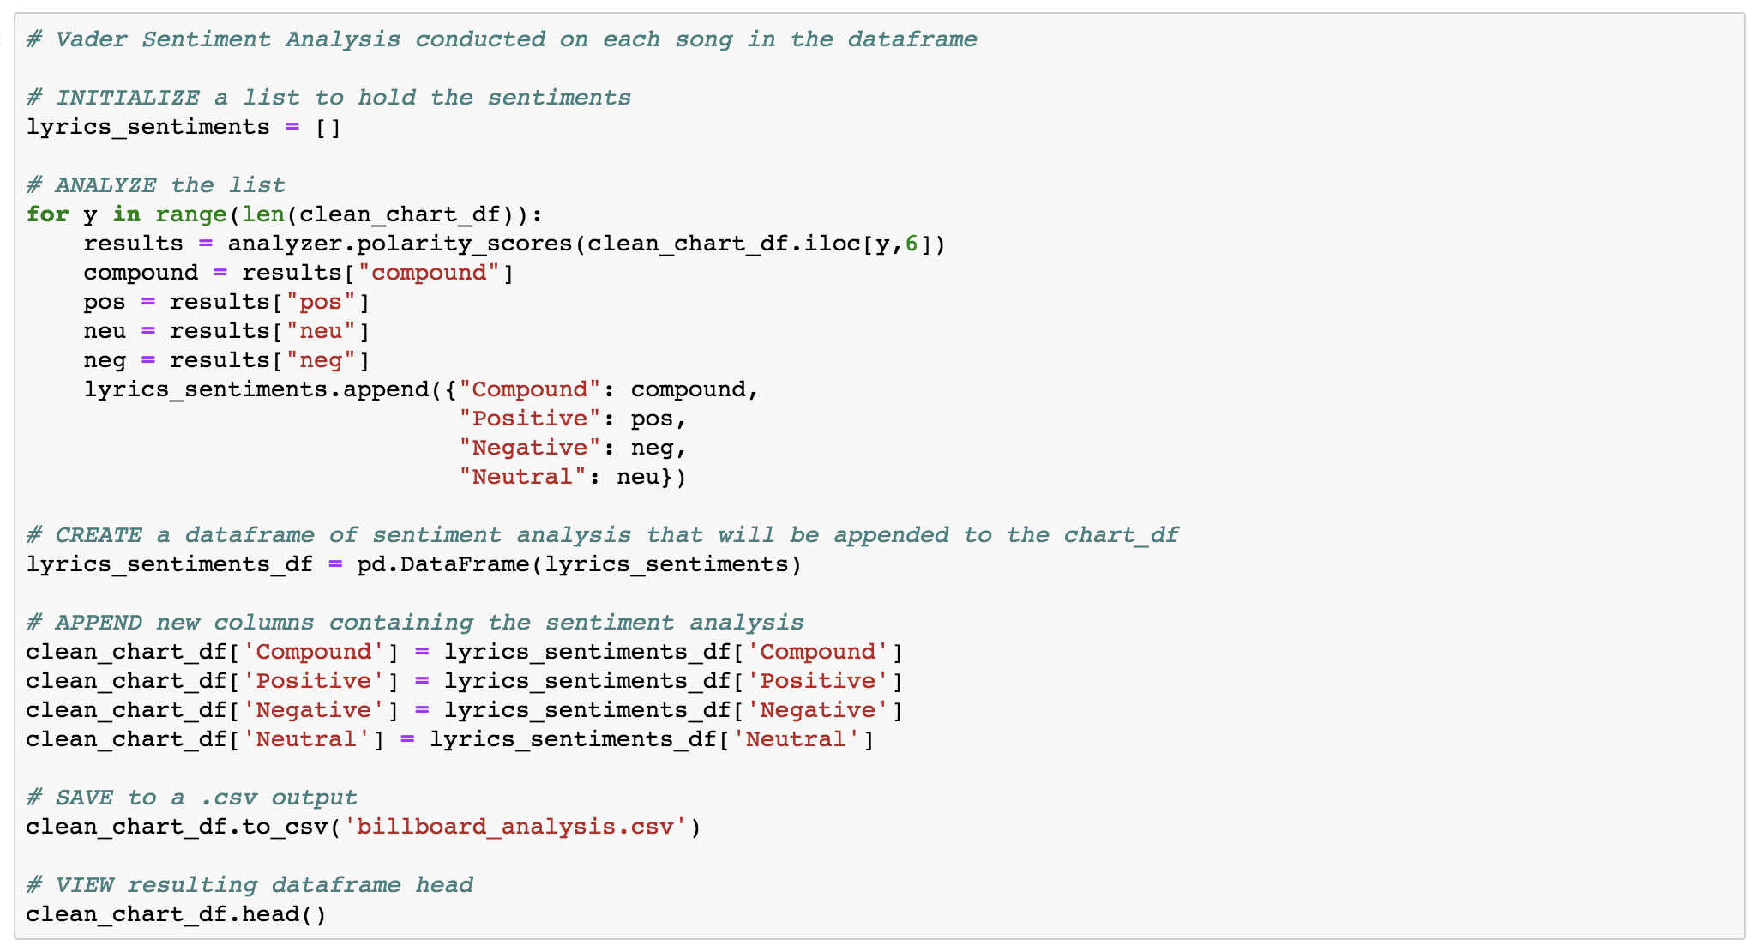
CODE (5) – Run VaderSentimentAnalysis

